Slide 1
GENERAL INFORMATION
Ieva Brence
TrainyFly
No. 2022-1-LV01-KA210-ADU-000084264

Slide 2

OUTLAY
Introduction
Objectives
Partners
Activities
Summary
TrainyFly
No. 2022-1-LV01-KA210-ADU-000084264
2

Slide 3
INTRODUCTION – WHY THIS PROJECT
Adult
learners
Need to develop and maintain their
skills
^{People with fewer} Special target group of the EU and
opportunities
Latvia
Educators
Need support for developing
International
experience exchange
online courses
Possibility to share experience on international level
TrainyFly
No. 2022-1-LV01-KA210-ADU-000084264
20XX
3

Slide 4
PEOPLE WITH FEWER OPPORTUNITIES
ADULT LEARNER
any adult who, having completed or being no longer involved
in initial education or training,
returns to some forms of non- vocational continuing
learning (formal, non-formal or
informal)
means people who, for economic, social, cultural, geographical or health reasons,
a migrant background, or for reasons such as disability and educational difficulties or
for any other reasons,
including those that can give rise to discrimination under article 21
of the Charter of Fundamental rights of the European Union,
face obstacles that
prevent them from having effective access to opportunities under the programme
TrainyFly
No. 2022-1-LV01-KA210-ADU-000084264
20XX
4

Slide 5
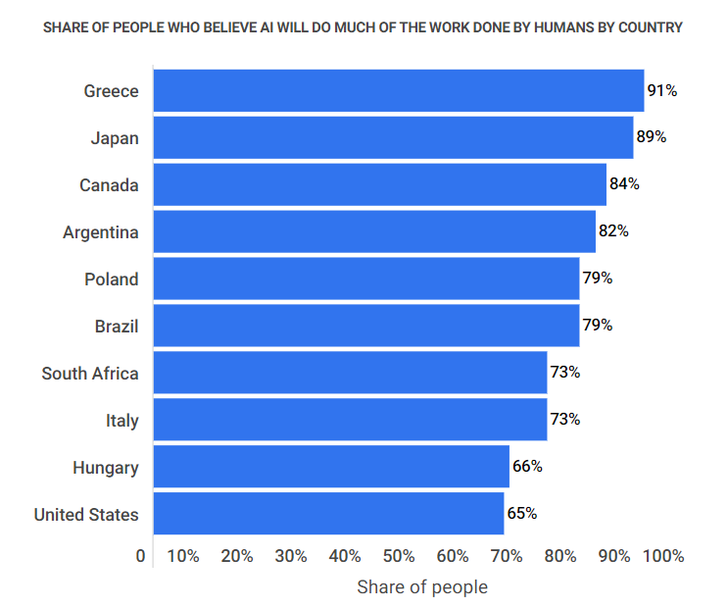
INTRODUCTION
https://www.zippia.com/advice/ai-job-loss-statistics/
Adult education is a priority as well
TrainyFly
No. 2022-1-LV01-KA210-ADU-000084264
23+ Artificial Intelligence And Job Loss Statistics [2023]: How Job Automation Impacts the Workforce - Zippia
20XX
5

Slide 6
THE OBJECTIVE: TO CREATE AND PROMOTE LEARNING OPPORTUNITIES AMONG ALL CITIZENS AND GENERATIONS VIA INTRODUCING AN ONLINE LEARNING PLATFORM, WHERE COURSES AIMED AT INCREASING DIGITAL SKILLS WILL BE AVAILABLE
SPECIAL BENEFIT WILL BE THE PSYCHOLOGICAL SUPPORT AND PROFESSIONAL GUIDANCE PROVIDED FOR THE TARGET GROUP MEMBERS - IN ORDER TO MOTIVATE THEIR FURTHER DEVELOPMENT
AND GROWTH, AND BETTER INTEGRATION INTO THE LABOUR MARKET
TrainyFly
No. 2022-1-LV01-KA210-ADU-000084264

Slide 7
TARGET GROUPS OF THE PROJECT
people with fewer opportunities in terms of education (unfinished secondary school or less)
people with disabilities
people having been unemployed for more than a year refugees (Ukraine being as the priority)
TrainyFly
No. 2022-1-LV01-KA210-ADU-000084264
7

Slide 8
RESULTS AFTER THE PROJECT
Courses – in all the native languages
500 persons (2 years after the project), at least 10 courses developed
TrainyFly
No. 2022-1-LV01-KA210-ADU-000084264
Course feel applied 2 years after the project
Career consultations and internships
20XX

Slide 9

RESPONSIBLE FOR THE PROJECT IMPLEMENTATION
5 partners
RESPONSIBLE PARTNER – LATVIA, MAGNETIC PROFESSIONAL
Experience in
adult learning
Founded in the first half of 2019. Since its establishment, we have been successfully engaged in the provision of professional development courses for adults, non-formal education and lifelong learning, as well as the implementation of various projects promoting education
Covering different parts of Europe
TrainyFly
No. 2022-1-LV01-KA210-ADU-000084264
20XX

Slide 10
PROJECT PARTNERS
Cross Culture International Foundation Cyprus, CCIF Cyprus youth established in 2016, to foster inclusive, peaceful and just local societies free from hate, fear and violence. CCIF Cyprus is active in the field of education, intercultural integration, audience development, trainings and informative seminars for the youth and adults
Cyprus
Pirkanmaan muotoilu- ja taideteollisuusyhdistys
Modus ry – a nationally renowned and recognized association that promotes professional design, arts and crafts. Currently, Modus has 60 members, who share a common set of values: high quality, ethics, and ecology
Finland
TrainyFly
No. 2022-1-LV01-KA210-ADU-000084264
20XX

Slide 11
PROJECT PARTNERS
Greece
Innovation Hive, goal is to find solutions to the new innovation challenges, to achieve Growth, Sustainability and maximize the impact to the society. Organization’s strategy is to conduct research and education as well as promote
innovation by accomplishing the involvement of society, academia, industry and public sector with the use of co- creation methodologies and a quadruple helix approach
Petit Pas aps - cooperate with schools, local
organization and institution for National
Operational Programs, Local Program and
Italy
organize events of combined school-work experience for about 60 students a year (16-19). Petit Pas has 3 school, 2 VET high school, 2 adult organizations, a social cooperative for the disabled like associate partners
11
TrainyFly
No. 2022-1-LV01-KA210-ADU-000084264
20XX

Slide 12
PROPOSED ACTIVITIES
PR1
PR2
PR3
PR4
Training event - The power of learning in digital environment
Elaboration of the Programme Toolkit
Programme platform and course delivery
Final meeting on the project results
TrainyFly
No. 2022-1-LV01-KA210-ADU-000084264
20XX
12

Slide 13
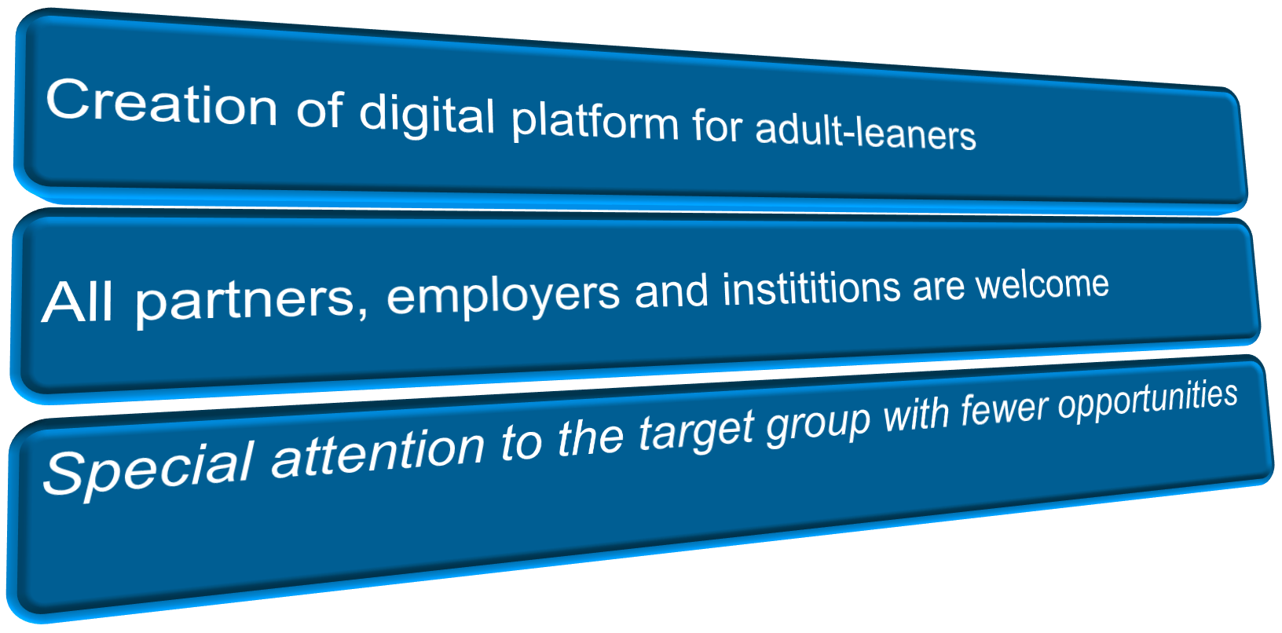

SUMMARY
TrainyFly
No. 2022-1-LV01-KA210-ADU-000084264
20XX
13

Slide 14
What has been done
Courses elaborated
Programme toolkit developed
Experience gained in working with people with fewer opportunities (unemployed persons)
Experience in working with students (different generations)

Slide 15
Work in groups
What are the main challenges in teaching people with fewer opportunities
https://miro.com/app/board/uXjVNi6_MD0=/?share_link_id=29741162313

Slide 16
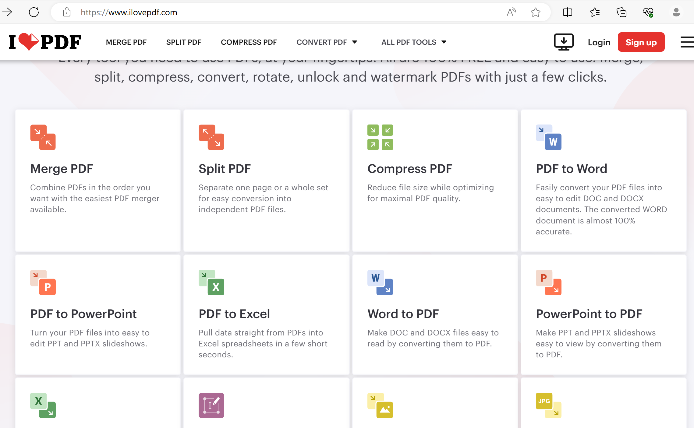
If one needs go convert files from the pdf format

Slide 17
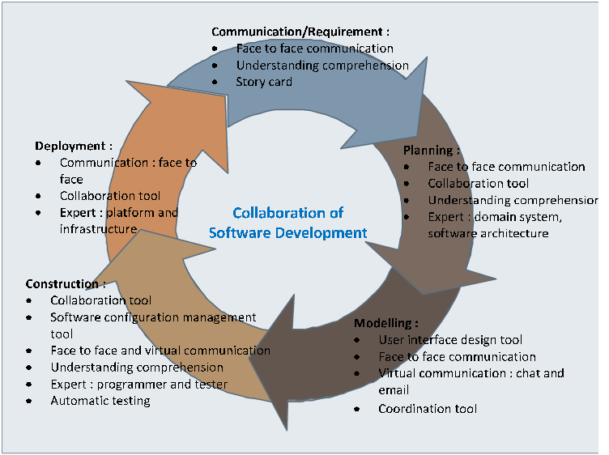
https://www.researchgate.net/figure/Collaboration-model-of-software-development_fig1_221013795

Slide 18
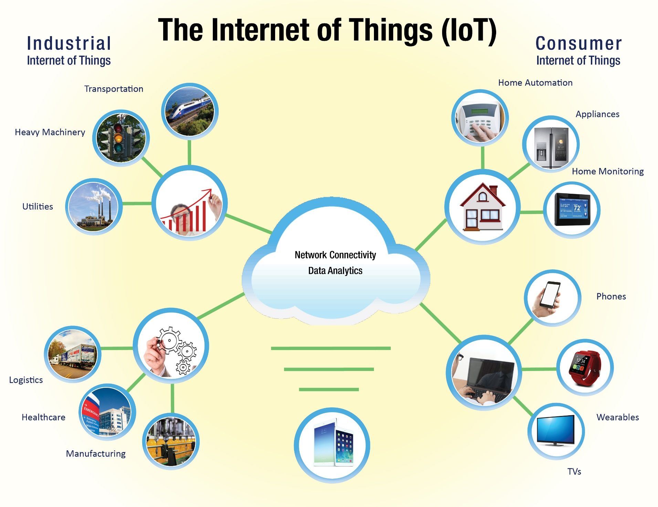
The Internet of Things and its Benefit to U.S. Water Customers (kuritaamerica.com)

Slide 19
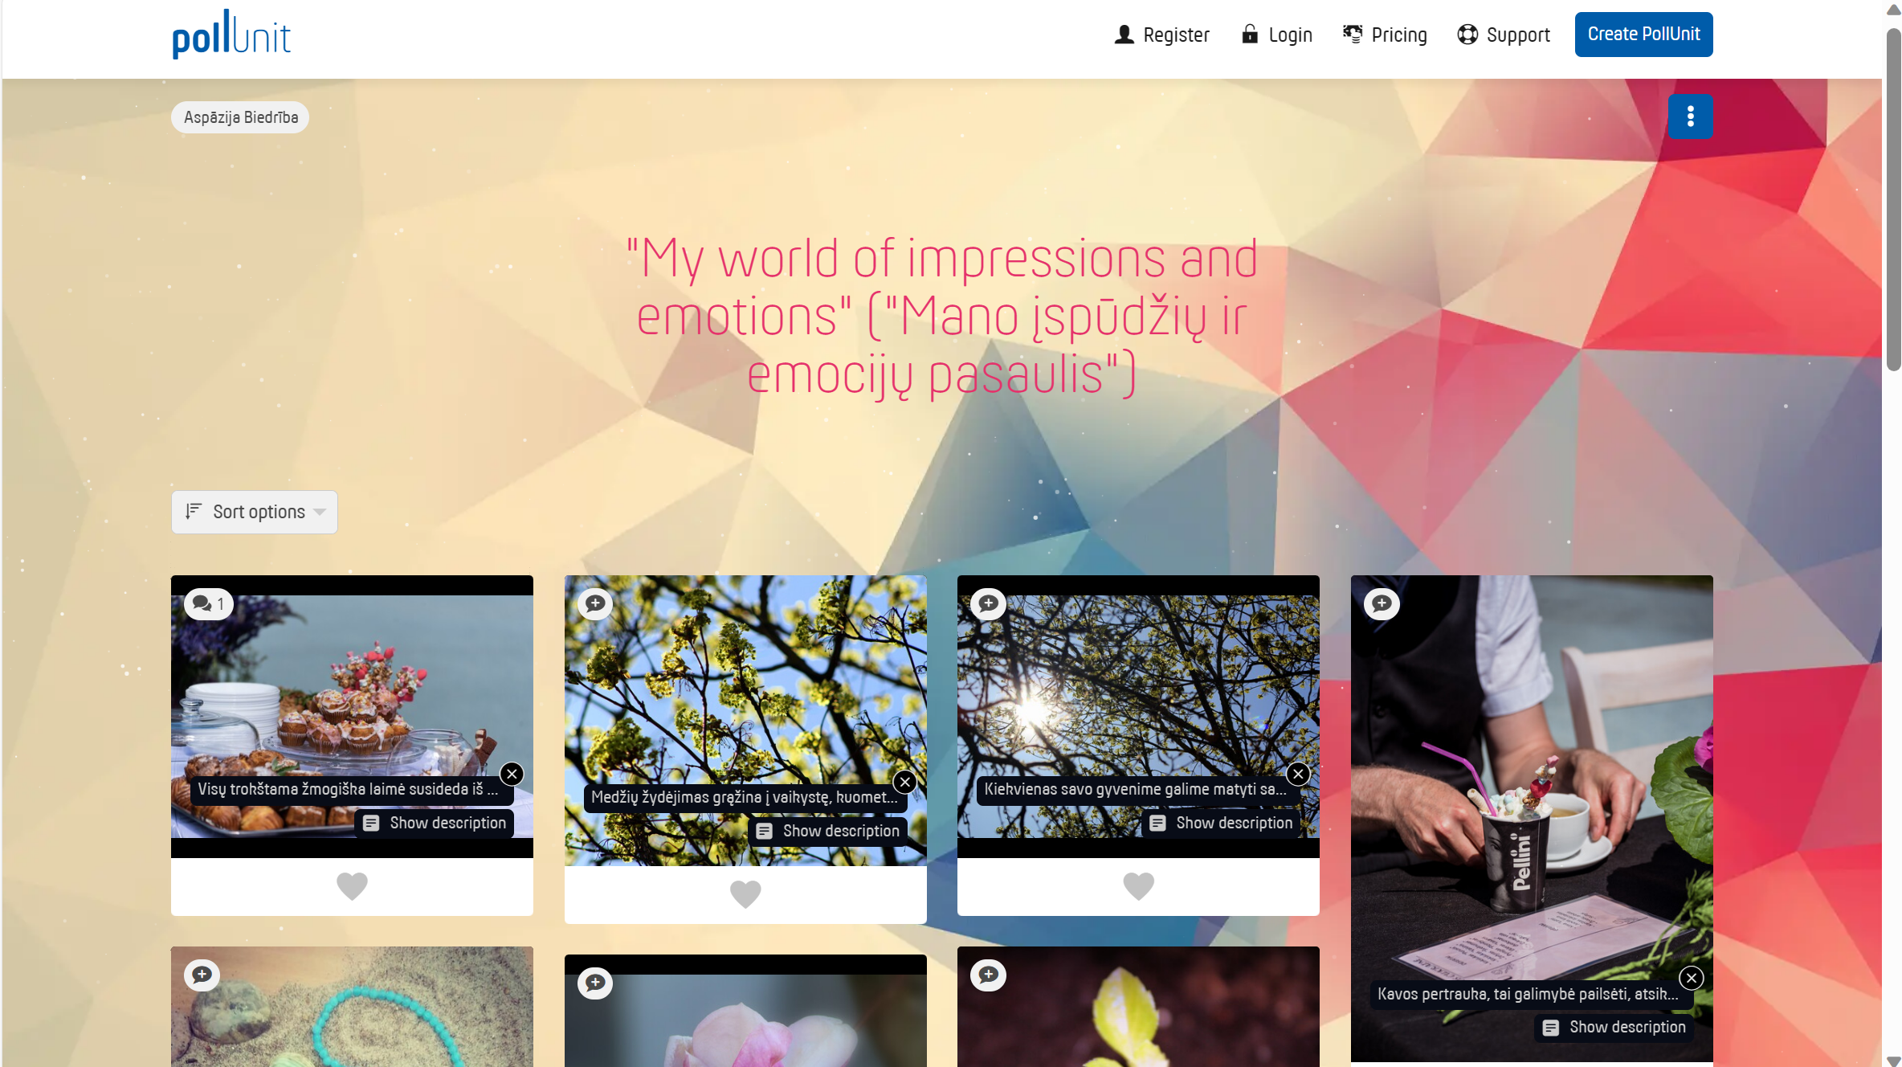
Pollunit (https://pollunit.com/) – to ensure «exhibition»of the works performed

Slide 20
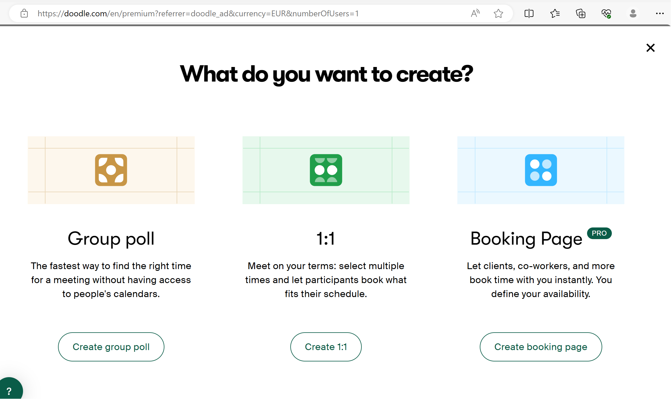
Doodle – possibilities to vote for the best time to organise a meeting

Slide 21
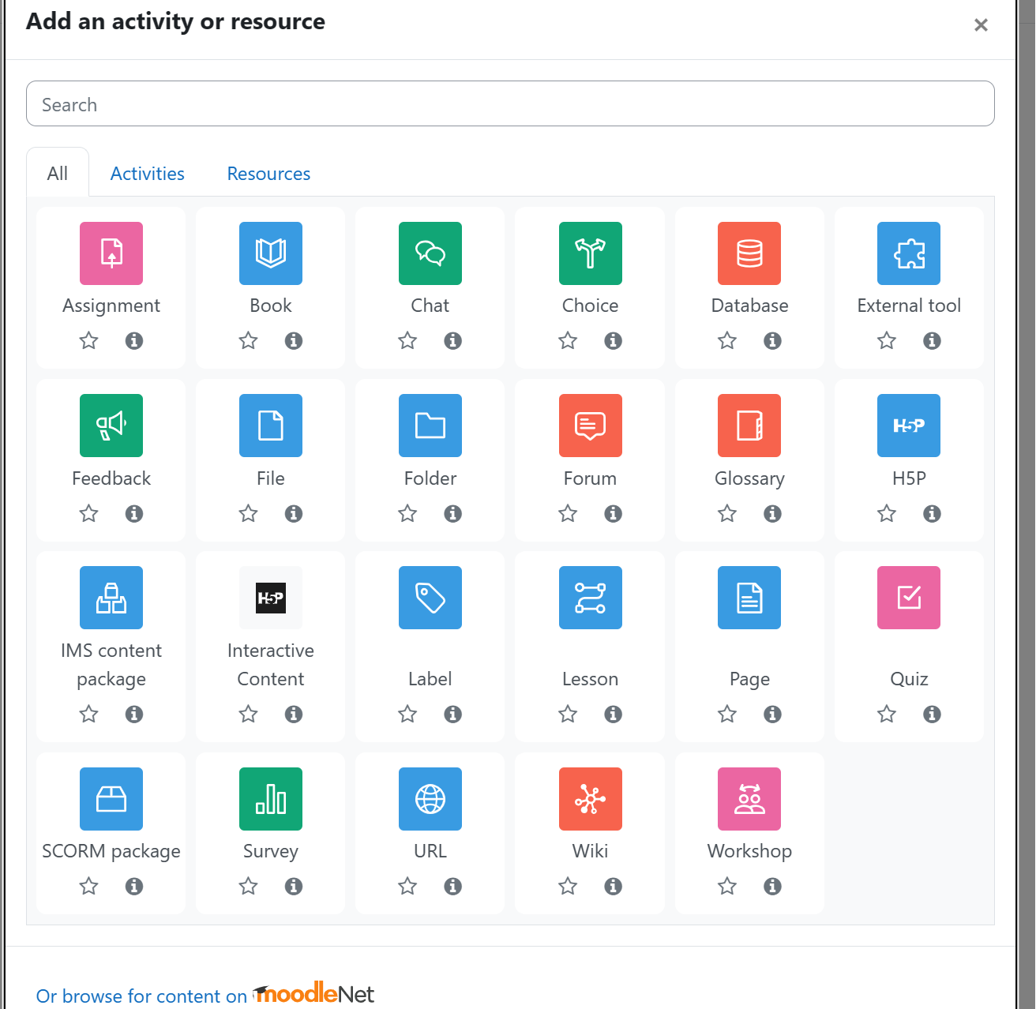
Moodle

Slide 22
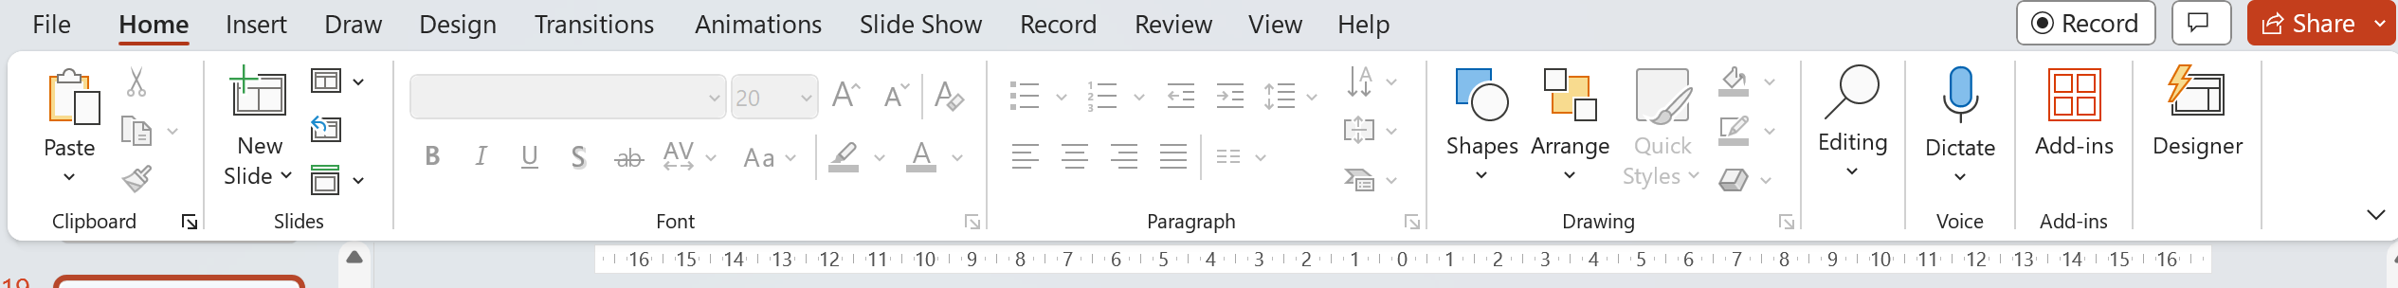
MsPower Point – there are many possibilites related to this programme

Slide 23
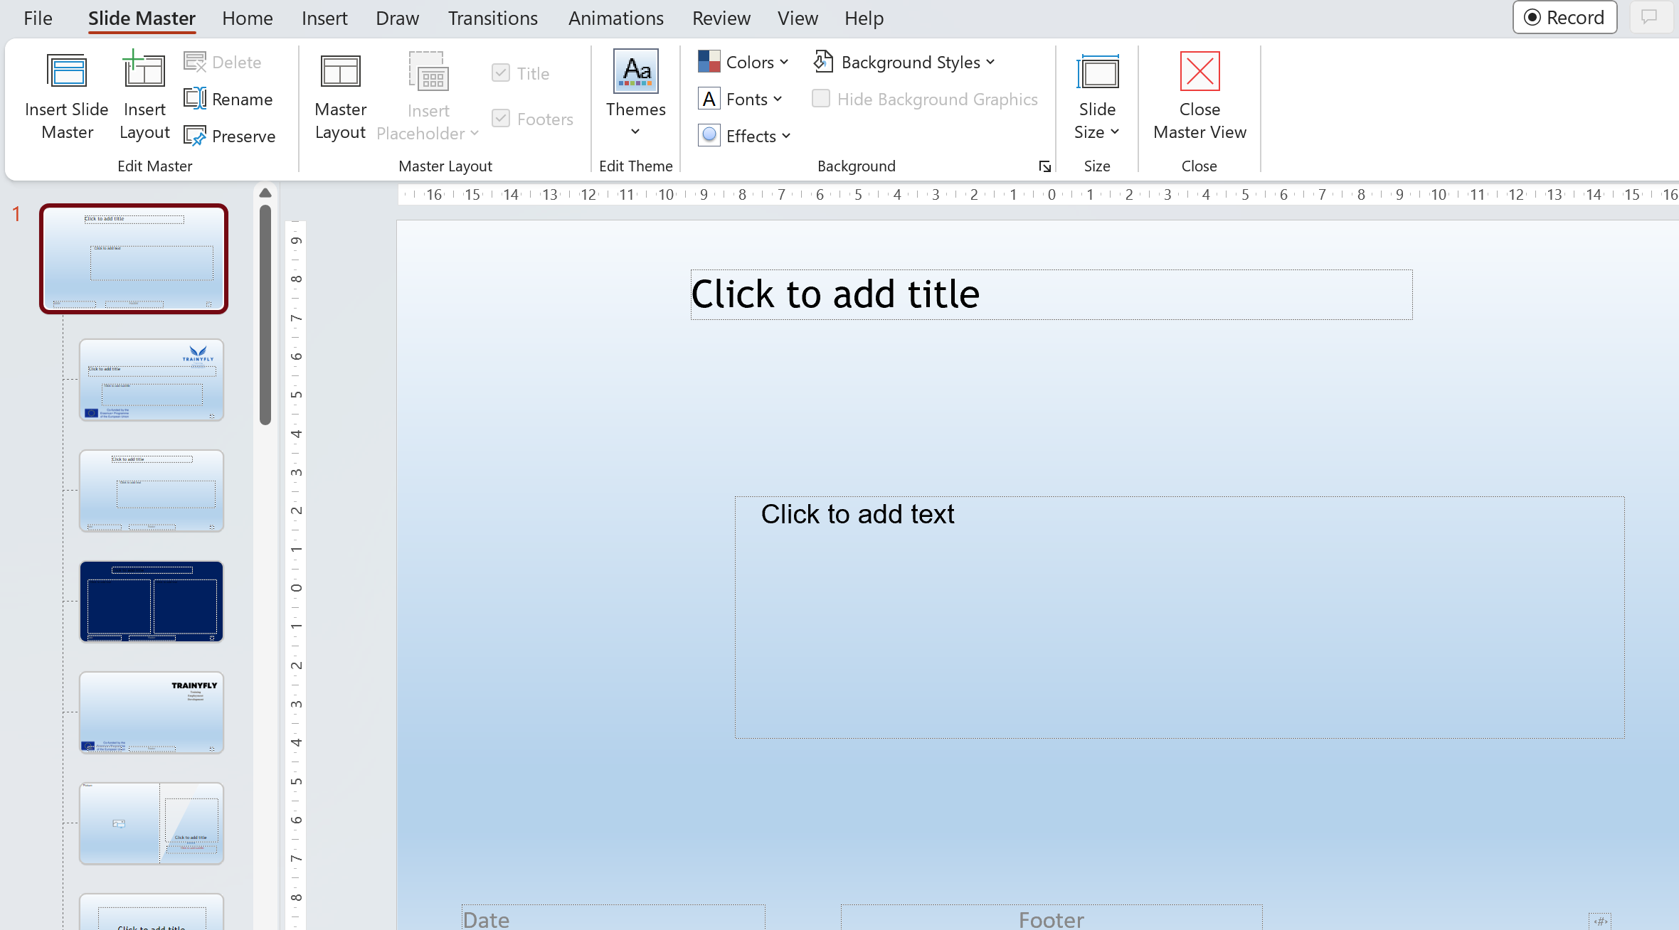
View – Slide Master – possibilities to adjust the templates of the slides

Slide 24
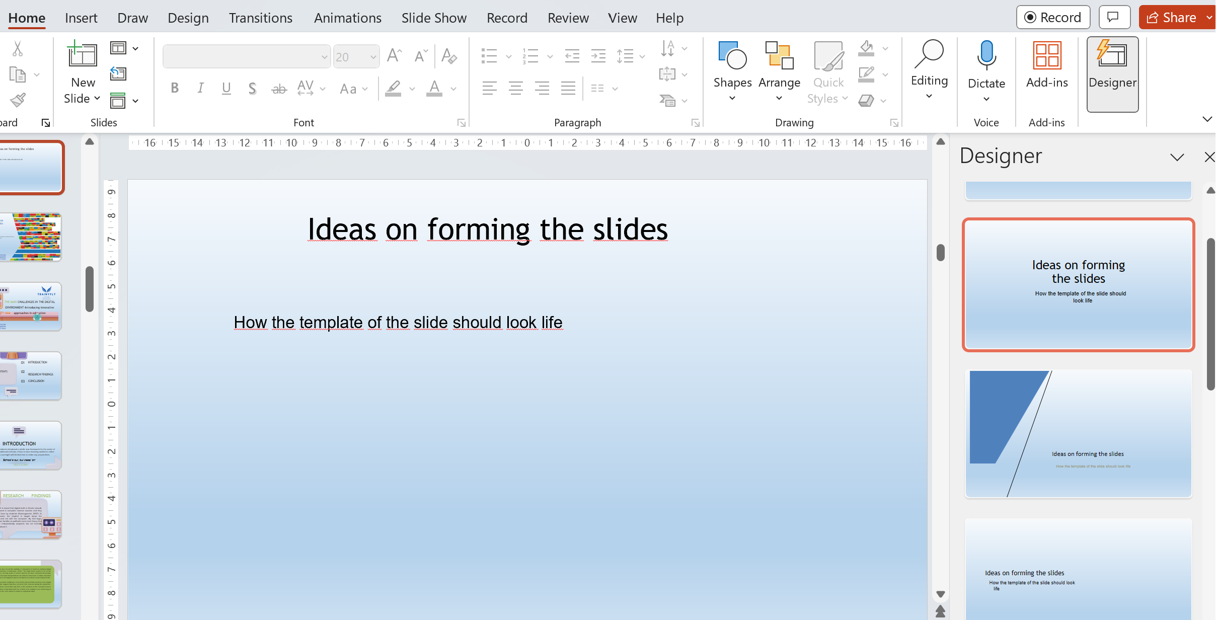
Ideas on forming the slides
How the template of the slide should look life

Slide 25
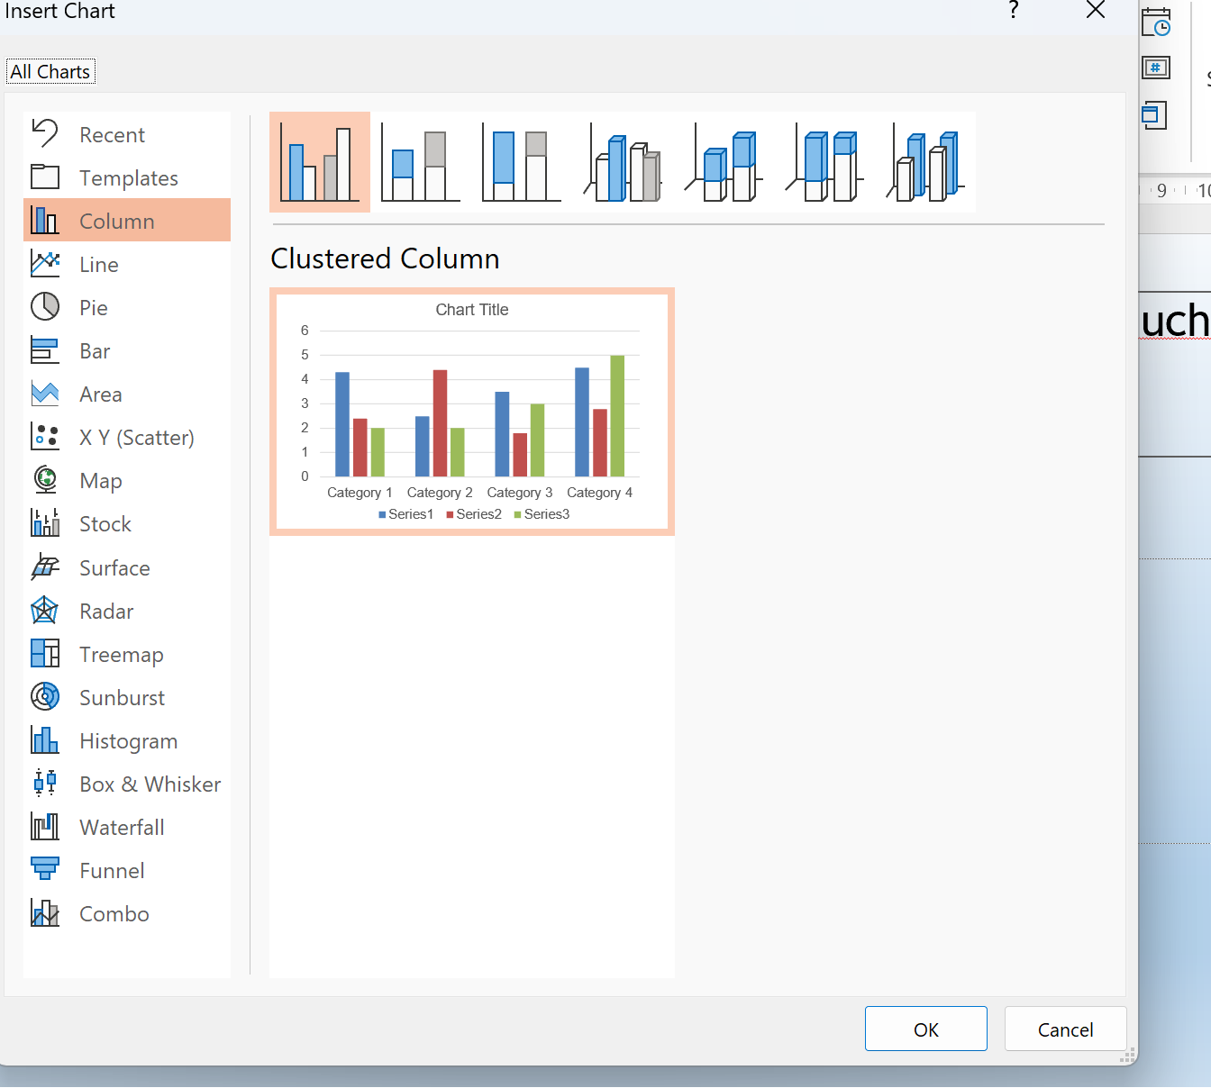
The possibilities in inserting Charts have become much easier in the MsOffice 365 version

Slide 26
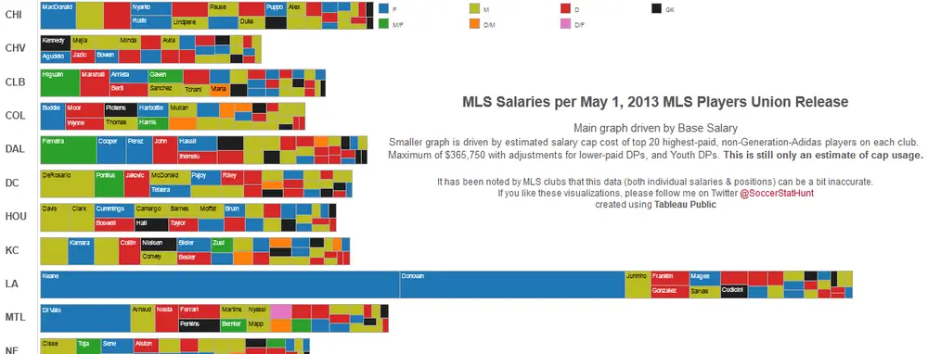
What one Should not do, if making graphs
https://www.businessinsider.com/the-27-worst-charts-of-all-time-2013-6

Slide 27
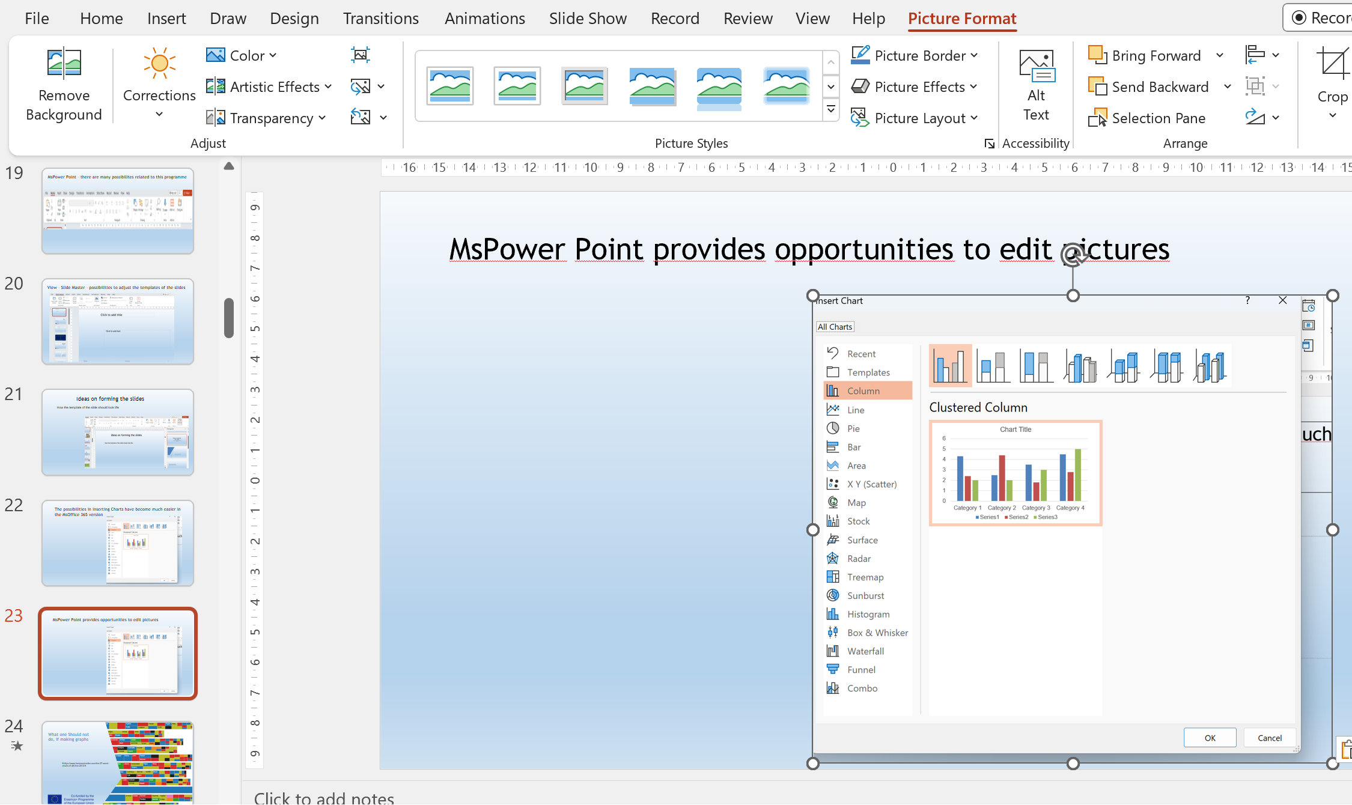
MsPower Point provides opportunities to edit pictures

Slide 28
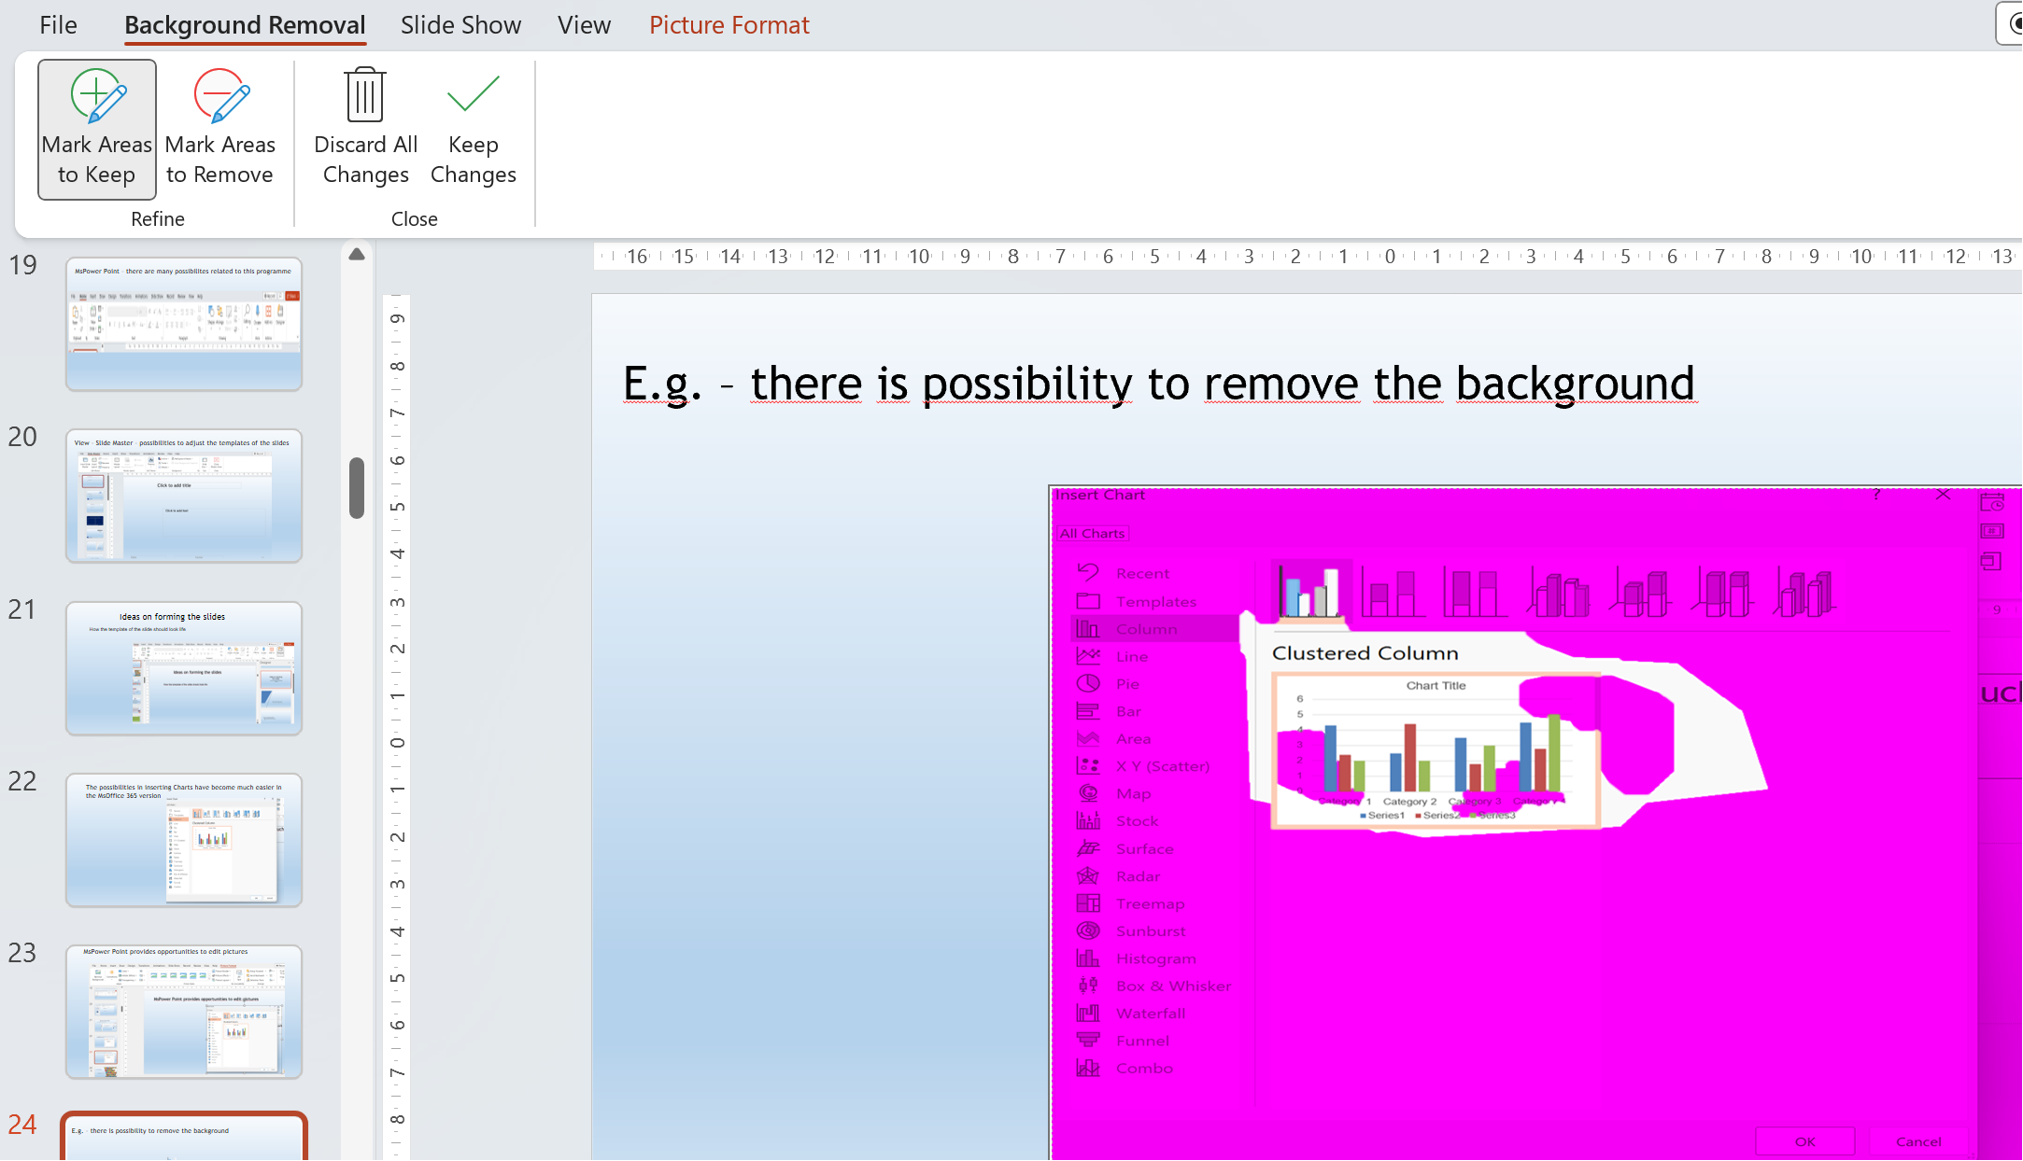
E.g. – there is possibility to remove the background

Slide 29
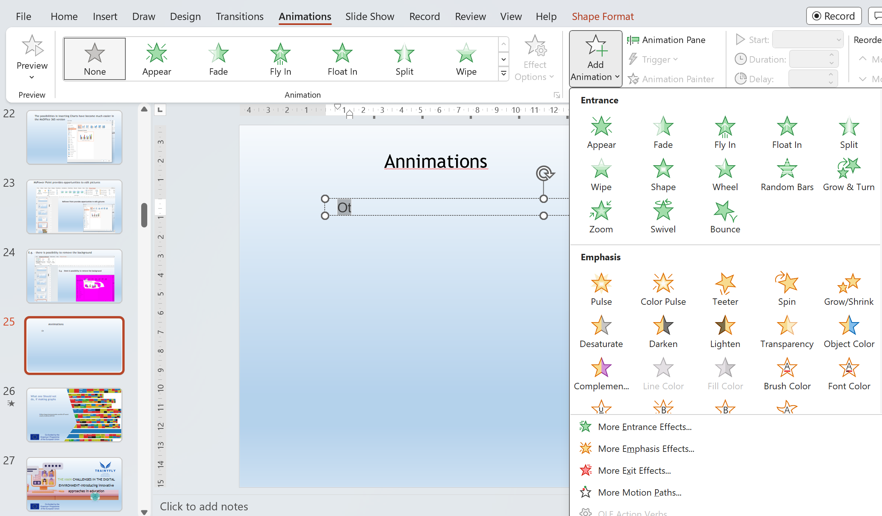
Animations

Slide 30
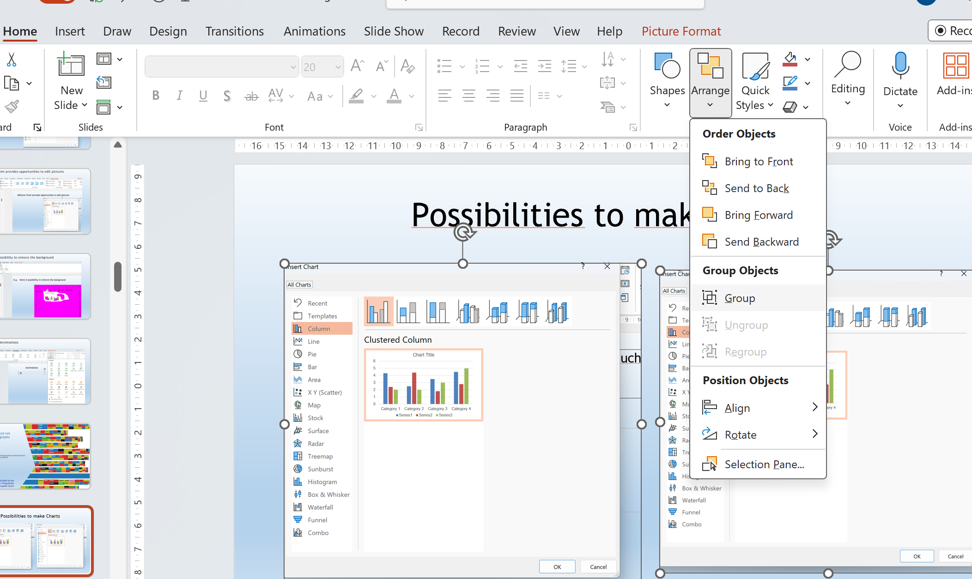

Slide 31
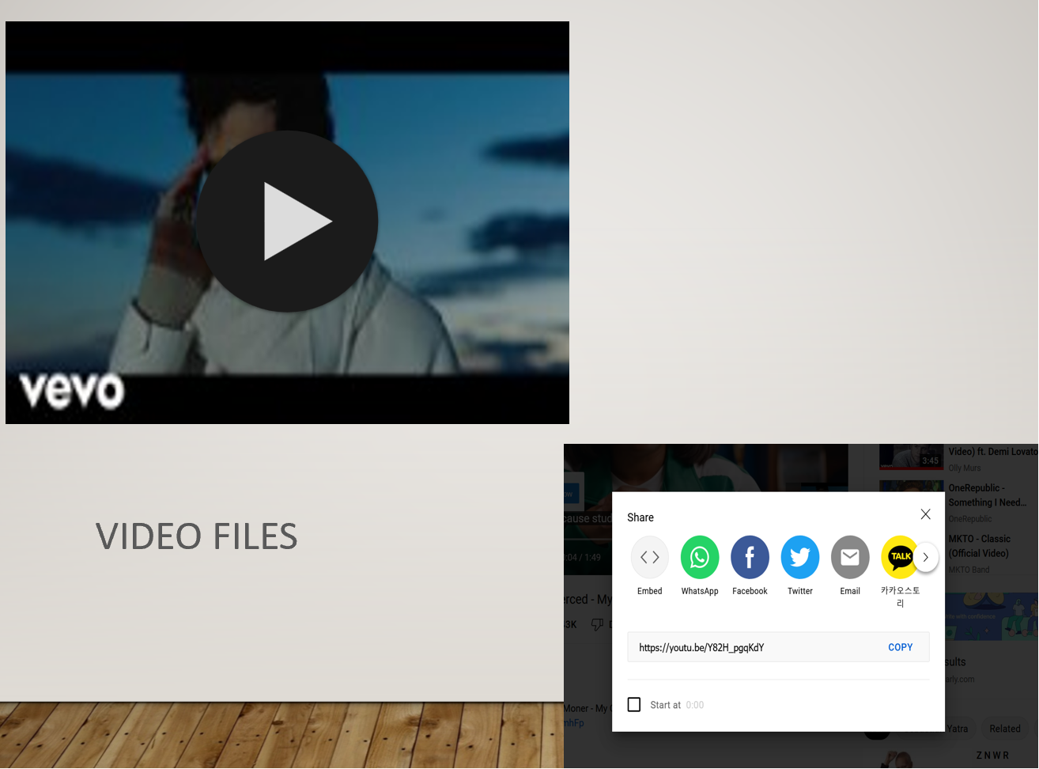
Possibilities to insert Video files in Power Point

Slide 32




ΤΗΕ ΜΑΙΝ CHALLENGES IN THE DIGITAL ENVIRONMENT-Introducing innovative approaches in education

Slide 33

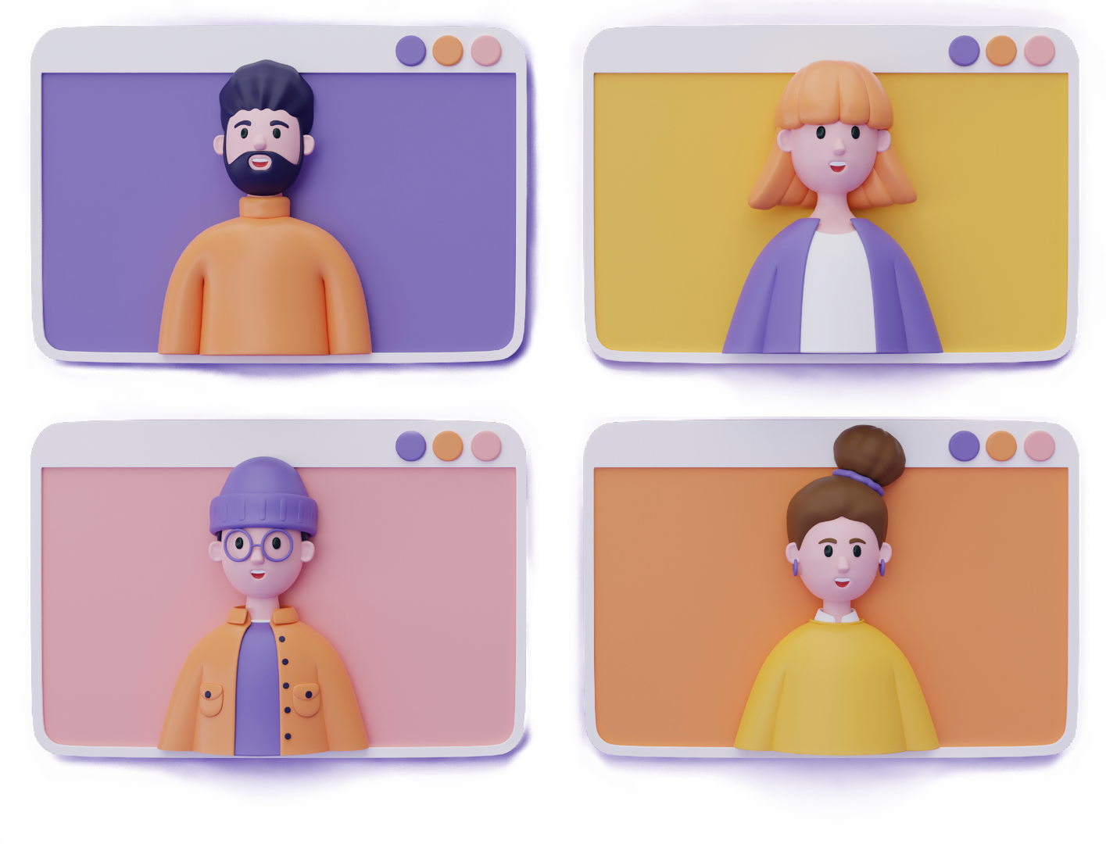
01
INTRODUCTION
TABLE OF CONTENTS
02
RESEARCH FINDINGS
03
CONCLUSION

Slide 34


INTRODUCTION
The COVID-19 pandemic introduced a whole new framework for the sector of education. The traditional methods of face-to-face teaching swifted to online environments overnight with limited time to make any preparetions.
School’s out, but class ’on'
(Zhou et al, 2020)

Slide 35

RESEARCH FINDINGS
Primarily, it is found that digital tools in Greek schools are only used in computer science courses and they are not in favor by students (Koutsogiannis, 2007). In this approach, the student is taught about the computer and not with the computer. By that logic, teachers are familiar as well with some tech theory that they have independently acquired, but not formally educated about it.

Slide 36
Research findings also reveal the inability of educators to teach by utilizing digital tools in their classrooms (Tzifopoulos, 2020). The main issue seems to lie on the teachers who have several years of service and do not have sufficient knowledge in digital media. Relevant interpretations are linked to their lack of initial education and training, which is not targeted and is not linked to modern social requirements.
In addition, the research of Nikiforos et al (2020) showed that teachers were highly dissatisfied with the support that they received from schools during the pandemic. Moreover it should be noted that only 50% of the teachers in the research believe that online education is important and few of them were willing to use technology in their courses once the were about to return to a physical class.

Slide 37
Actionaid Hellas published on January 2022 via an Erasmus+ project (MigratED) a report revealing the inequalities of education that came to the surface during the pandemic (Chatzoudi et al, 2020). Within this analysis, more that 100 educators are providing information with their views and a focus groups boosts the report with further information and comments. The thematic areas that emerged are:
Lack of formal training in using the technology
Insufficient equipment
Insufficient platforms to support online teaching
Unequal access to online lessons
Lack of personal contact and interaction with the students
Nevertheless, the educators did not seem to had a negative attitude towards digital technologies in classroom as several of them would like to adopt them in face-to-face courses. But they do highlight that support on behalf of the government is necessary in order to succeed.

Slide 38



CONCLUSIONS
There is not technological readiness in Greek schools
Teachers views vary
More support is needed
Positive attitude to be created

Slide 39
Using digital solutions and artistic approaches in learning process – Canva for Artisans

Slide 40
What is Canva?
Free tool for graphic design- visual outlook (not a photo editing program!)
Presentations, social media, infographics, photo banks and collages, posters, CVs, brochures etc.
Free version is usable for artisans
There is a pro version too, and also single elements can be purchased
Works on browser, does not need to be downloaded in PC Lots of free photos, fonts and graphic elements

Slide 41
PRIMARY GOALS
To learn how to create a Canva account
To know the basic tools
To create and download own design

Slide 42
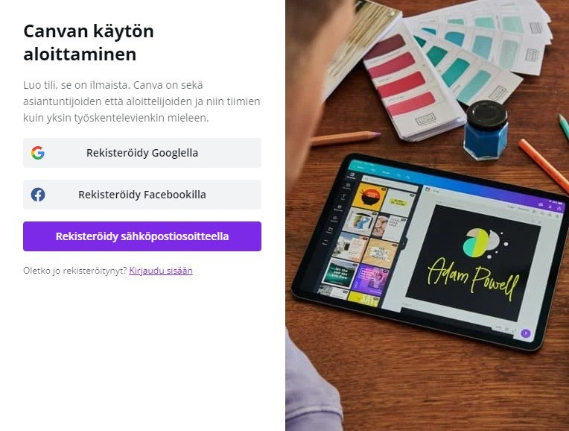

CREATE A USER ACCOUNT
Click "Register with email address"
User account can also be created with personal Google account or your Facebook profile, but email registration is recommended as a safer option
Create a password for your account. A good password is unique and contains both uppercase letters, lowercase letters and special characters. Avoid reusing or recycling old passwords.

Slide 43
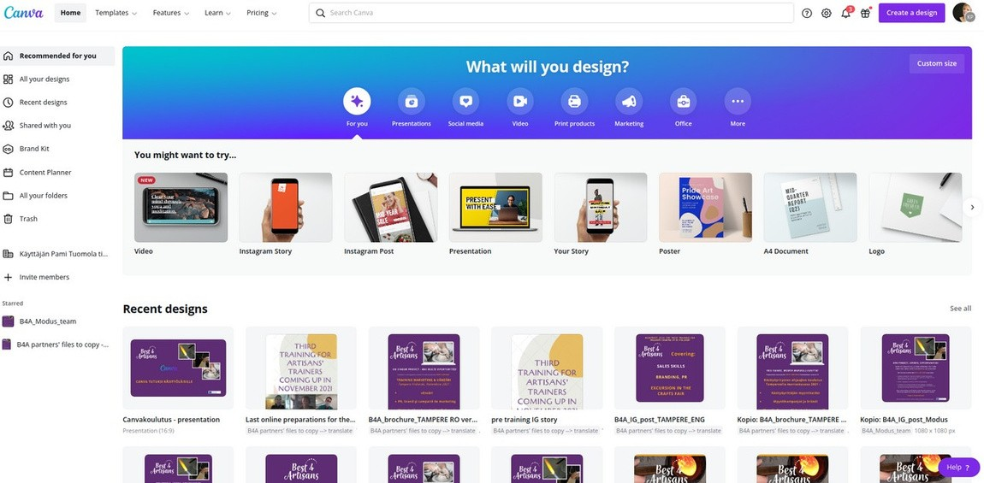
STARTING A NEW DESIGN
Canva has lots of templates — all professionally designed and fully customizable for your needs. To choose or find a template, click an example of a design under "What will you design" or click on the left bar "All designs" and scroll down, or click "Create a design" on the upper right corner
symbol.

Slide 44
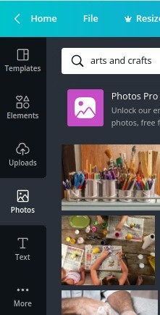
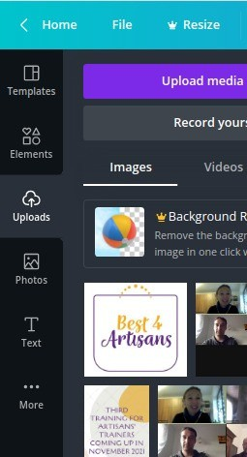
USE PICTURES IN CANVA
PHOTOS :
Canva has a photo bank
Diversity of pictures Search using words or browse by category
UPLOAD YOUR OWN
PICTURES:
Upload from your pc to Canva Choose icon "Uploads" and "Upload media"
Canva saves the uploaded pictures in your own library
In case you want to remove the uploaded picture, move it to trash from the grey-dots-icon on the upper right corner of the selected picture

Slide 45
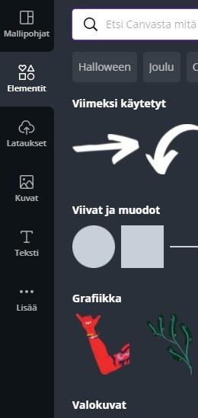
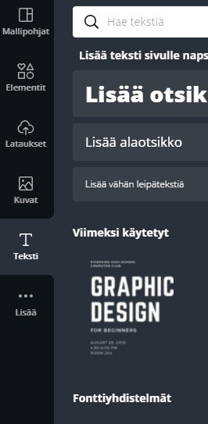
TOOLS
ELEMENTS:
Lines and shapes Graphics
Photos Videos Sound Frames Grids
TEXT TOOLS
Add heading Add subheading Add body text
Text templates (for example labels etc.)
Fonts

Slide 46


EDIT PICTURES AND TEXTS
In the upper corner of the editor, you'll find a menu to edit text and pictures. In the menu you can:
Choose a font
Change the size and colour of the text Change the layout of text paragraphs Add effects
Change the colour settings of pictures Add an effect on a photo

Slide 47
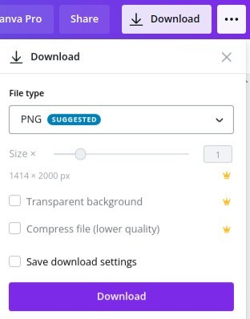
SAVE AND DOWNLOAD YOUR DESIGNS
Canva saves yor designs automatically. To download a file to your pc hard disc, click icon and choose a suitable format for your design:
PNG JPG
PDF - standardi PDF - print MP4-video
GIF

Slide 48
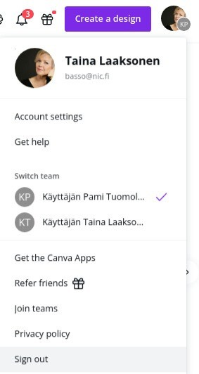
THE END
As you stop working, return to the front page and click the "initials/cover photo" button on the upper right corner and choose "Sign out". Remember to sign out always, especially when using a shared computer.
Flying Digital - Training, Employment, Development (TrainyFly)
No. 2022-1-LV01-KA210-ADU-00008140264

Slide 49


SUMMARY
Canva is a free tool for graphic design: presentations, social media, posters etc.
You can create your own user account and make your own designs
Use free templates,pictures (your own or from Canva), graphic elements, text tools
Save and download your design
Flying Digital - Training, Employment, Development (TrainyFly)
No. 2022-1-LV01-KA210-ADU-00008141264

Slide 50


Particularities on working with different target group learners (e.g. unemployed, people with lower education, etc.)

Slide 51
Challenges in adult education
A global crisis was needed to force education, including adult education, to recognize its limitations. A quick adaptation to the new situation is not only necessary, but this time is mandatory.
The COVID-19 pandemic, for example, has increased the pace of change, with distance education putting an even higher demand on communication skills.
The “skills gap” between what employers are looking for, and the actual skill level of many job-seeking adults, has generated particular interest in adult education.

Slide 52
MORE ADULT EDUCATION
˝The world of work is changing. We need more adult education, not less˝ said Alan Tuckett in a very interesting article published two years ago in The Guardian.
HOW?
Plans for change and modernization (AE stucked in the 90s);
The legislation is outdated in a lot of countries, with almost non-existent government investments for professional training in trades and occupations that are necessary for the real economy;
Some training providers place little to no importance on preparing for the launch of a new professional course, which just leads to the material prepared for teaching as rushed and inadequate.

Slide 53
Highlighted current trends in adult education
The covid situation has sped up the evolution of education with the acceptance of remote learning, therefore,
many businesses have had to quickly adapt to remote work;
teachers, schools, students … have all had to adapt to remote education;

Slide 54
Specifically designed for adults who are either:
- returning to education after a significant break or
- are seeking to learn new skills or knowledge later in life or
- people with fewer opportunities in EU
In recent years, main trends reflect changes in society and the economy, increasing importance of lifelong learning in the 21st century.
Educational opportunities

Slide 55
Significant changes reflect on
  the changing needs and preferences of learners;
  the needs of the economy and the labor market;
  the needs of society;

Slide 56
Current trends in adult education
Online, mobile and blended
The majority of professional adult training providers have been caught completely unprepared by the COVID-19 world crisis, with some countries taking delayed and inappropriate steps in regulating these forms of training.
Better Feedback
Adaptive learning systems and platforms are providing real-time feedback, and digital curriculum usually includes embedded assessments.
Employer partnerships
Projects can be completed quickly by experienced learners and more slowly by workers that need more time and support.˝

Slide 57
TRENDS
Online learning....
One of the biggest trends in adult education is the increasing use of online platforms for learning.
With the rise of the internet and the proliferation of online courses, adults can now access educational resources from anywhere and at any time.
Online learning allows adults to balance their studies with their work and other commitments, making it an attractive option for many.

Slide 58
Microlearning........
Microlearning techniques involve breaking down complex subjects into smaller, more manageable chunks of information;
Easier for adults to absorb and retain new knowledge;
Focus on one topic at a time rather than trying to take in a large amount of information all at once.

Slide 59
Personalized learning...
Personalized learning is an educational approach that customizes learning for each student’s strengths, needs, skills, and interests
takes into account the individual needs, preferences, and learning styles of each learner;
allows adults to progress at their own pace and to focus on the areas that are most relevant to them;

Slide 60
Gamification.....
Gamification involves using game-like elements, such as points and rewards, to make learning more engaging and enjoyable;
This trend is particularly popular among adult learners, who may find traditional methods of learning to be boring or tedious;
Gamification can make learning more interactive, helping adults to stay motivated and engaged.

Slide 61
Collaborative learning......
Collaborative learning approaches involve working with others to achieve a shared goal;
Collaborative approaches can take many forms, including group discussions, team projects, and peer feedback;
This type of learning can be particularly effective for adult learners, as it allows them to share their experiences and knowledge with others, and to learn from one another.

Slide 62
Increasing focus
Skills training and professional development.
As the economy changes and new technologies are developed, it is important for adults to stay up-to-date with the latest skills and knowledge in their field.
Many programs now focus on providing practical, hands-on training that can help adults advance in their careers or enter new fields.
This includes programs in areas such as technology, healthcare, and business, as well as more general skills such as leadership and communication.

Slide 63



Lifelong learning
Growing recognition of the importance of lifelong learning.
In the past, it was common for people to complete their education in their youth and then not return to formal learning for the rest of their lives. However, in today's rapidly changing world, it is increasingly important for adults to continue learning and adapting throughout their careers.
Programs are designed to be flexible and allow students to learn at their own pace, as well as in the increasing number of employers who value employees who are willing to continuously learn and improve.

Slide 64
Conclusions
The trends in adult education reflect the changing needs and preferences of learners, as well as the increasing availability of educational resources online.
These trends are helping to make learning more accessible, engaging, and personalized for adults, and are helping to ensure that they have the skills and knowledge they need to succeed in today's rapidly changing world.

Slide 65
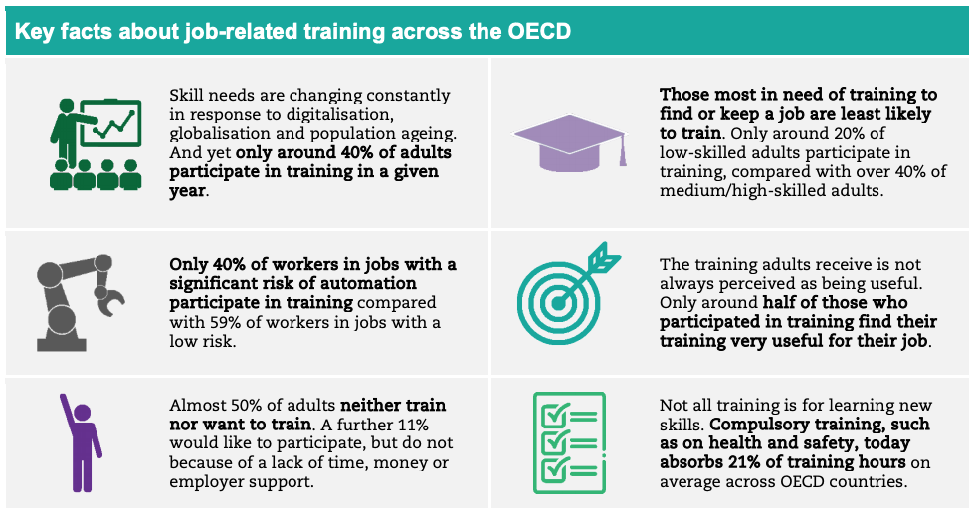

Slide 66
REFERENCES
Koutsogiannis, D. (2007). Exploitation of Information and Communication Technologies in the teaching of literary courses and especially in the Greek language teaching. Research on the philologists trained in the Odyssey project. Thessaloniki: Greek Language Center [In Greek].
Tzifopoulos, M. (2020). I teach, educate and utilize technology: the triptych of success in modern school?. Review of Educational and Scientific Issues (ΕΡΚΥΝΑ), 19, 85-94 [In Greek].
Zhou, L., Wu, Sh., Zhou, M., & Li, F. (2020). 'School’s out, but class ’on'. The largest online education in the world today: taking China’s practical exploration during the COVID-19 epidemic prevention and control as an example. Best Evid Chin Edu, 4(2), 501-519.
Nikiforos, S., Tzanavaris, S. and Kermanidis, K.L., 2020. Post-pandemic pedagogy: Distance education in Greece during COVID-19 pandemic through the eyes of the teachers. European Journal of Engineering and Technology Research.
Chatzoudi, D. I., Mourtzaki, M., Dirogianni, D. and Stamatokou, C. (2020) The inequalities of education in Greece during the pandemic. Actionaid Hellas. MigratED project. Available at: https://www.actionaid.gr/sites/default/files [In Greek]

Slide 67
Social inclusion issues in education, professional guidance of the learners

Slide 68




WHAT ARE THE ADVANTAGES OF ONLINE LEARNING?
Accessing the classes from any location
Recorded lectures
Can be easily personalized Environmentally friendly Creativity
Flying Digital - Training, Employment, Development (TrainyFly)
No. 2022-1-LV01-KA210-ADU-000084264

Slide 69

ACCESSING THE CLASSES FROM ANY LOCATION
Flying Digital - Training, Employment, Development (TrainyFly)
No. 2022-1-LV01-KA210-ADU-000084264

Slide 70
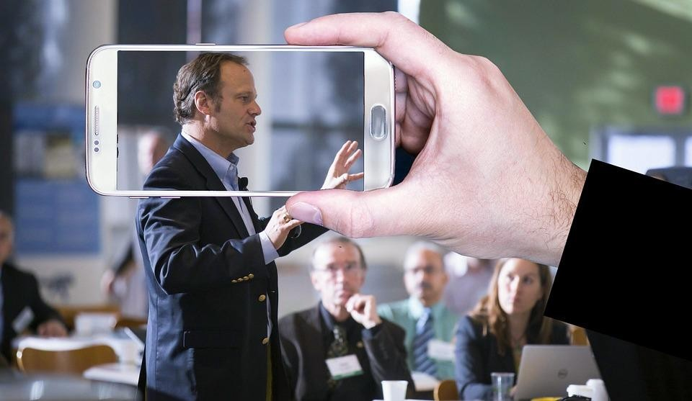
RECORDED LECTURES
Flying Digital - Training, Employment, Development (TrainyFly)
No. 2022-1-LV01-KA210-ADU-000084264

Slide 71
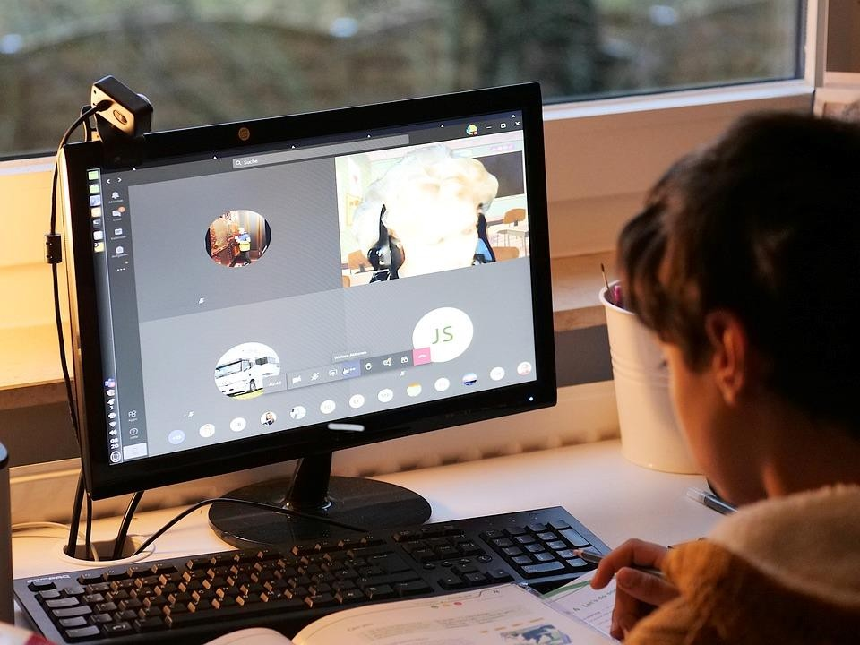
CAN BE EASILY PERSONALIZED
Flying Digital - Training, Employment, Development (TrainyFly)
No. 2022-1-LV01-KA210-ADU-000084264

Slide 72

ENVIRONMENTALLY FRIENDLY
Flying Digital - Training, Employment, Development (TrainyFly)
No. 2022-1-LV01-KA210-ADU-000084264

Slide 73

CREATIVITY
Flying Digital - Training, Employment, Development (TrainyFly)
No. 2022-1-LV01-KA210-ADU-000084264

Slide 74
WHAT ABOUT THE DISADVANTAGES?
Technology problems
Lack of social contact
Time management skills and self-motivation are needed
Flying Digital - Training, Employment, Development (TrainyFly)
No. 2022-1-LV01-KA210-ADU-000084264

Slide 75

TECHNOLOGY PROBLEMS
Flying Digital - Training, Employment, Development (TrainyFly)
No. 2022-1-LV01-KA210-ADU-000084264

Slide 76
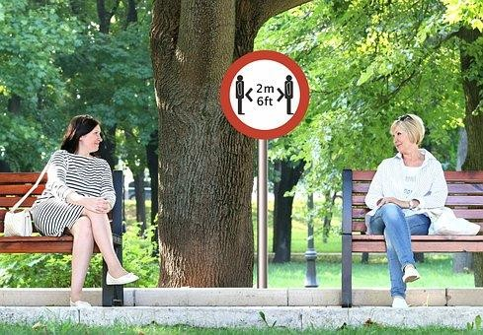
LACK OF SOCIAL CONTACT
Flying Digital - Training, Employment, Development (TrainyFly)
No. 2022-1-LV01-KA210-ADU-000084264

Slide 77
LACK OF SOCIAL CONTACT
Flying Digital - Training, Employment, Development (TrainyFly)
No. 2022-1-LV01-KA210-ADU-000084264

Slide 78



ITS EASIER TO COMMUNICATE WITH THOSE WHO HAVE NOT COMPLETED THEIR EDUCATION PROGRAMM
Social network
Marketing/remarketing
Offers for opportunities
Flying Digital - Training, Employment, Development (TrainyFly)
No. 2022-1-LV01-KA210-ADU-000084264

Slide 79
Online and offline learning courses
Online and offline
Offline challanges
«Tips and trick»
Summary

Slide 80
INTRODUCTION
It's a greatest illusion - thought, that record of an online lecture can be successfully used for e-learning (offline)!

Slide 81
Online and offline
similarities and differences

Slide 82
The only common in learning online or offline is need of some technological equipment (computer, tablet, smartphone, etc.).
Everything else are very different!

Slide 83
Differencies
ONLINE
OFFLINE
Emulation of on site learning process - lecturer and learner occupies the same "time and space" - all participants of online learning session are present in one virtual space at the same time.
Instant reflection («feedback»)!
Lecturer creates a something - encodes his/her knowledge in some kind of entity (information carrier) and learner tries to decode and learn.
Is there any reflection?

Slide 84
aTTENTION
ONLINE
OFFLINE
Jokes, "small talk", questions, experience stories, group exercises, ad hoc pauses, etc. - full set of improvisation instruments!
Zero improvisation!
Only main payload!
Very strict plan (scenario)!

Slide 85
Scenario – some tips
Split the big story (topic) in 15-20 min logical parts - e.g., every subtopic is logical part;
Every part is small story - with beginning, essence, conclusion;
After every part it is essential to create prerequisites for learner’s reflection;
Next part can begin with the main conclusions from previous part;
Every example must been detailed, but not too much - to avoid offtopic!

Slide 86
Voice timbre
To be monotonous is bad (=learner will feel asleep);
To be too emotional is worst, this is not a movie, lecturer’s goal is not to draw emotional response!
Finding the golden mean is a challenge - it depends on a field and even a topic!
The same goes to lecturer's appearance, if in offline learning material is included video - the best algorithm is "less is more"!

Slide 87
Tuning process
Find «guinea pig» (better – 3-4) - preferable a person, who knows nothing in a field/topic.
Ask to learn 2-3 subtopics (logical parts);
Define the necessary reflection (or level of understanding) and verify that the result has been achieved;
Then ask for feedback (honest);
Tune according to results and feedbacks given;
Understand when the tuning process is done - wish to create absolute perfection is the road to nowhere!

Slide 88
Summary
To be effective in offline learning - forget everything you know about on-site or online learning!
This is completely different paradigm! ☺

Slide 89
THANK YOU
Ieva Brence
ieva@magneticpro.lv
TrainyFly
No. 2022-1-LV01-KA210-ADU-000084264
20XX
PRESENTATION TITLE
14

